Slide 1
A missing piece of the puzzle
Dr. Rahman Ullah
Fellow Interventional Cardiology
Peshawar Institute of Cardiology

Slide 2
HPE
Nasreen, 51 year old, presented with Shortness of breath, NYHA-III and palpitations.
She has a history of RHD- severe Mitral Stenosis, managed medically.
On exam, she had irregular heart rate of 120, chest auscultations revealed basal crepts on the back and an opening snap followed a rumbling diastolic murmur.

Slide 3
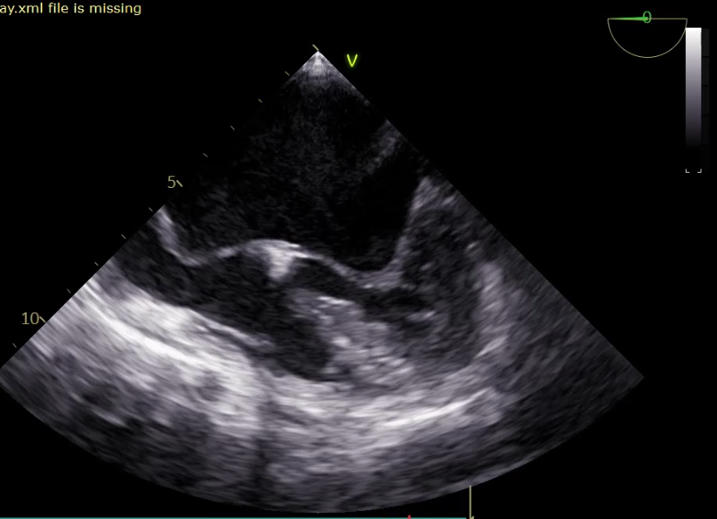
TEE shoed sever mitral stenosis, A very large LA, a huge Interatrial septum Aneurysm

Slide 4
First, the conventional approach from right femoral vein for septostomy was used.
The three drops from SVC to RA then Aorta and finally IVC were not observed.
Due to the complex anatomy procedure postponed and planned the next day with support of TEE guidance and cautery.

Slide 5
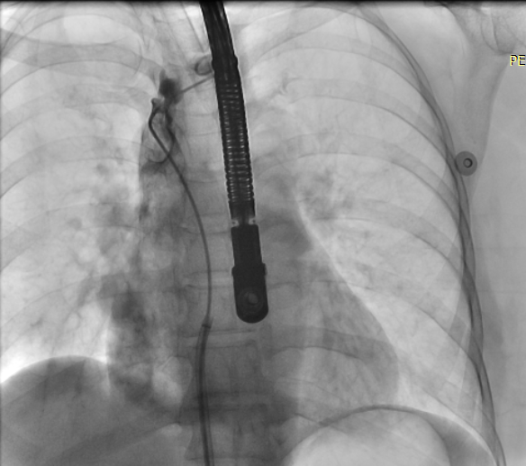
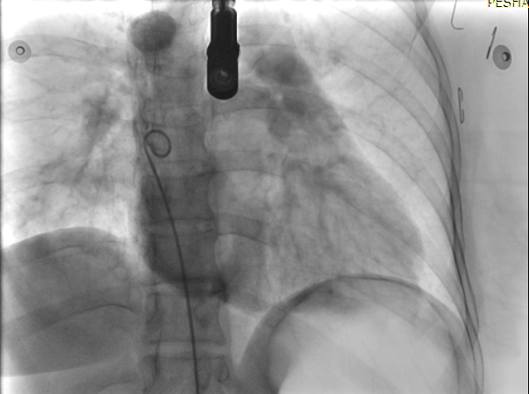
Next day again, Mullen sheath was not visible in RA nor traditional landmarks were seen on fluoroscopy.

Slide 6
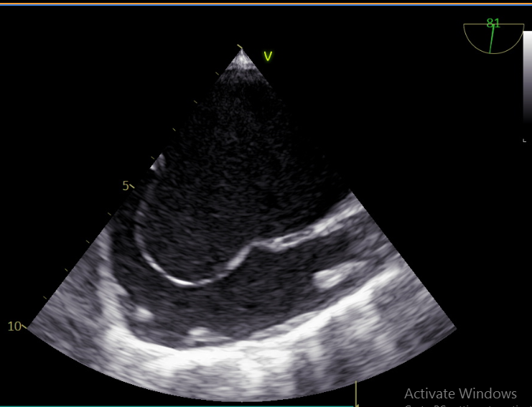
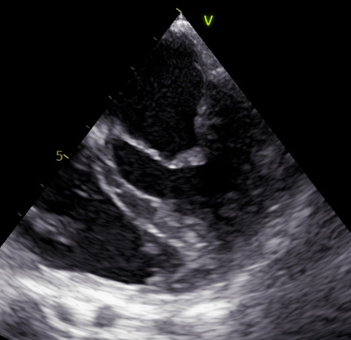
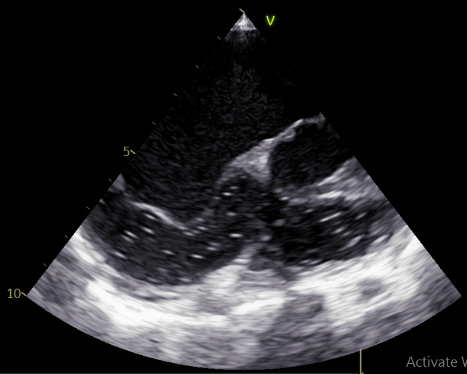

Slide 7
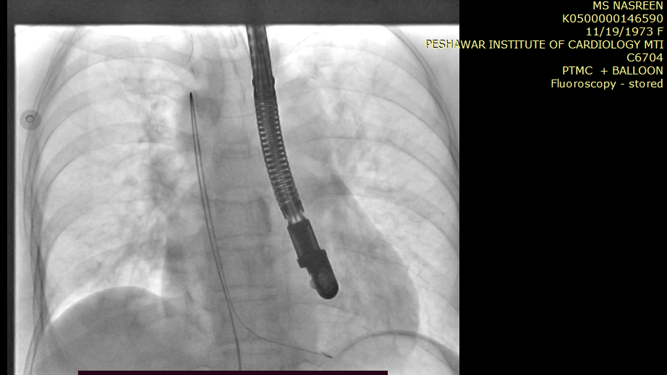
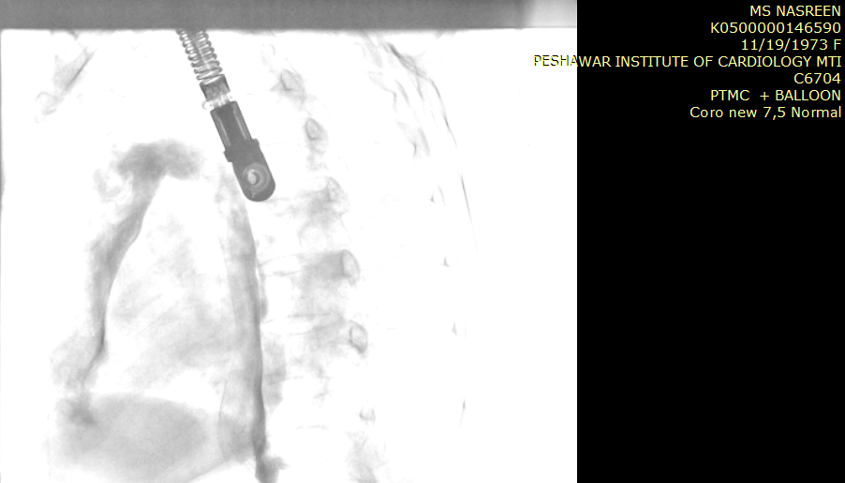
In this uncertain situation the flouroscopy and guide wire finally helped.
J wire from IVC –Azygos vein—SVC
--RA--RV
Azygos vein from IVC to SVC

Slide 8
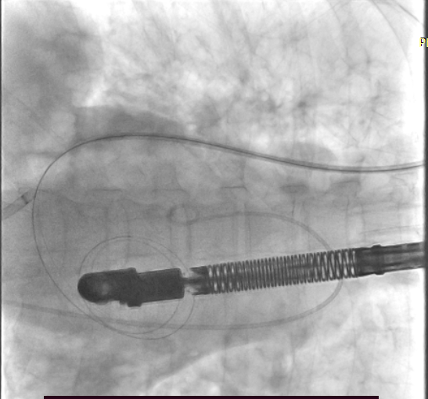
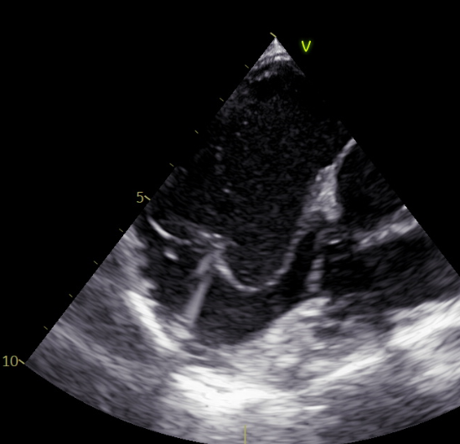
Access shifted to Internal jugular vein.
Septostomy done under TEE guidance. LA wire placed but it couldn’t support IBC.

Slide 9
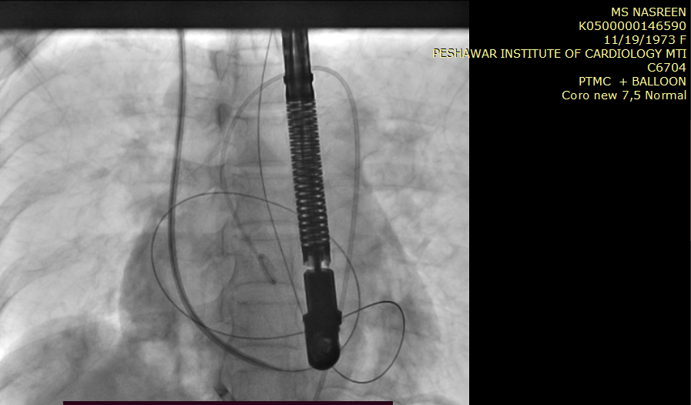
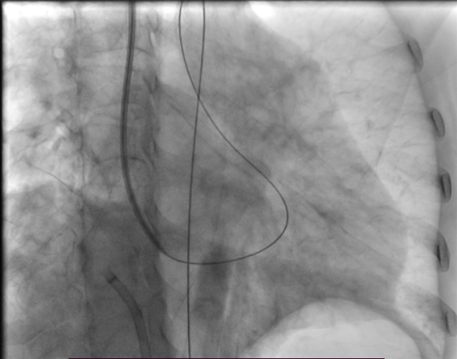
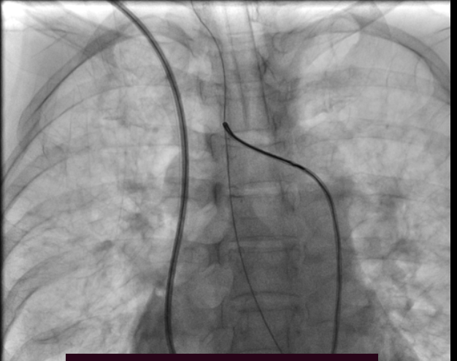
Terumo Exchanged length wire passed from LA to LV and then Aorta.
From RSA it was snared and pulled out via RFA sheath for maximum support of IBC.

Slide 10
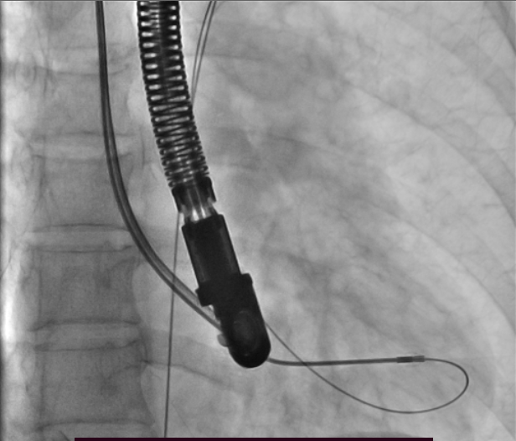
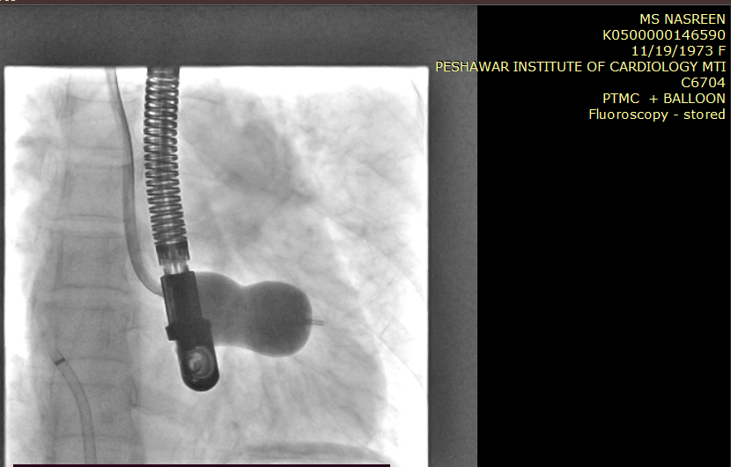
IBC passed across MV and optimum balloon dilation done.

Slide 11
